Slide 1
SESSION 14
Transformers &
Attention Mechanisms
Self-Attention · Vision Transformers (ViT) · DETR
Computer Vision & AI — Theoretical Session

Slide 2
What We'll Cover Today
1
2
3
Self-Attention
Vision Transformers (ViT)
DETR
How transformers let every token communicate with every other token simultaneously — the core QKV mechanism.
Applying transformer architecture to images by treating patches as tokens — no convolutions needed.
End-to-end object detection using transformers — eliminating anchors and NMS with set prediction.

Slide 3
Why Transformers? The Problem with RNNs
❌ RNNs / LSTMs — Limitations
✅ Transformers — Solutions
✗
Sequential processing — one token at a time
✓
Parallel processing — all tokens at once
✗
Long-range dependencies fade (vanishing gradients)
✓
Global attention — any token can attend to any other
✗
Cannot be parallelised during training
✓
Scales efficiently on GPUs and TPUs
✗
Bottleneck: hidden state must carry all context
✓
Context is shared directly, not bottlenecked
"Attention Is All You Need" — Vaswani et al., 2017

Slide 4
The Core Idea: Attention
Every token can directly communicate with every other token — in parallel.
💡 Analogy:
"The cat sat on the mat" — to understand what "sat" means, the model asks: which other words are relevant to me? It finds "cat" (the subject) and "mat" (the location) directly, without scanning sequentially.
The
cat
sat
on
the
mat
"sat" attends to "cat" and "mat"
Key insight: attention weights are learned — the model decides what matters.

Slide 5
Step 0: Words → Vectors (Embeddings)
Before attention, each token is converted to a dense numerical vector that captures its meaning.
Word → Embedding Vector
Sentence as a Matrix
"cat" → [ 0.23, -0.14, 0.87, 0.05, … ] (512 dims)
The
[ 0.xx, -0.xx, 0.xx, … × 512 ]
Similar words have similar vectors:
• "cat" ≈ "dog" (both animals)
• "cat" ≠ "airplane" (very different)
The embedding space encodes
semantics as geometry.
cat
[ 0.xx, -0.xx, 0.xx, … × 512 ]
sat
[ 0.xx, -0.xx, 0.xx, … × 512 ]
on
[ 0.xx, -0.xx, 0.xx, … × 512 ]
a
[ 0.xx, -0.xx, 0.xx, … × 512 ]
mat
[ 0.xx, -0.xx, 0.xx, … × 512 ]
Matrix shape: (6 tokens × 512 dimensions)

Slide 6
Self-Attention: The Q, K, V Framework
Each token plays three roles simultaneously — Query, Key, and Value.
Q
K
V
Query
Key
Value
"What am I looking for?"
"What do I represent?"
"What is my actual content?"
Represents what the current token needs from others.
Like a search query.
Advertises what information this token can provide.
Like a database index.
The information that gets passed on if attention is high.
Like the actual data returned.
These are created by multiplying the same input embedding by three different learned weight matrices: W_Q, W_K, W_V

Slide 7
Intuition: Attention as a Soft Database Lookup
Think of attention like a fuzzy search engine that returns blended results instead of exact matches.
Component
Database Analogy
Attention Role
Query (Q)
Search term you type
What this token is looking for
Key (K)
Tags / index of each record
What each other token advertises
Value (V)
Actual content of the record
Information passed if relevant
Attention Weight
Relevance score / ranking
How much to weight each Value
Unlike a real database, attention returns a weighted blend — all values contribute, proportional to their relevance.

Slide 8
The Scaled Dot-Product Attention Formula
Attention(Q, K, V) = softmax( QKT / sqrt(dk) ) x V
1
2
3
4
Compute Scores: QKᵀ
Scale by √dₖ
Softmax → Weights
Weighted Sum of V
Dot product of Query with every Key → measures similarity. Score = how relevant is token j to token i?
Divide by square root of key dimension. Prevents scores from getting too large, keeping softmax gradients healthy.
Convert scores to probabilities (0-1, sum to 1). Each weight tells us how much to attend to each position.
Multiply each Value by its attention weight and sum. Result = new enriched representation for this token.

Slide 9
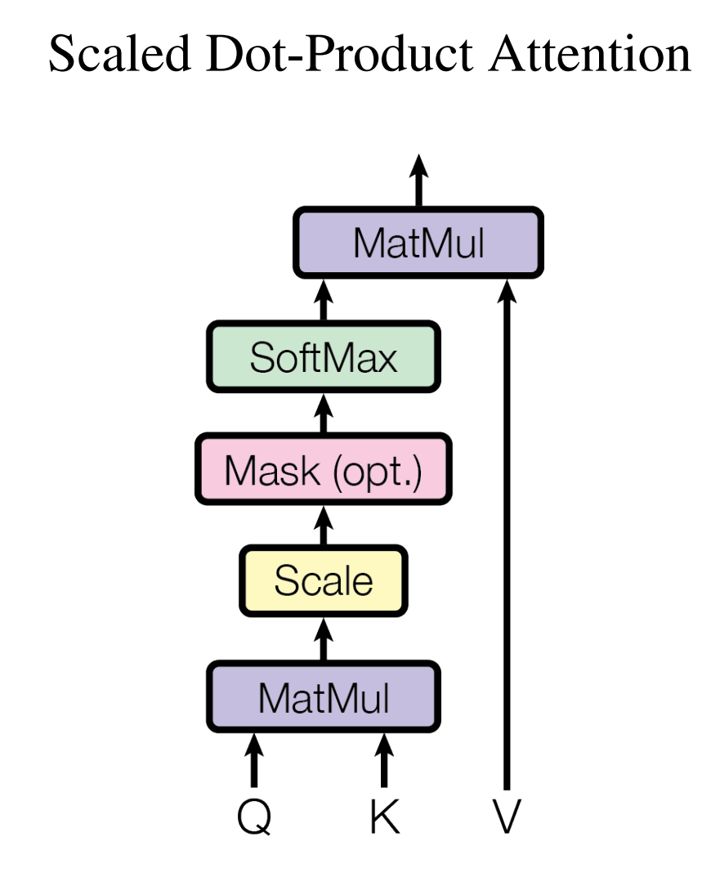
Scaled Dot-Product Attention — Architecture Diagram
Q, K, V inputs
Same input, projected via W_Q, W_K, W_V weight matrices.
MatMul (QKᵀ)
Dot product gives raw attention scores between every pair.
Scale (÷√dₖ)
Stabilises gradients. Without this, softmax becomes too peaked.
Softmax
Converts scores to probability weights that sum to 1.
Final MatMul (×V)
Weighted combination of values — the enriched output.
Source: jtlicardo.com/blog/self-attention-mechanism

Slide 10
Multi-Head Attention: Multiple Perspectives
Instead of one attention function, run h parallel attention heads — each learns different relationships.
Head 1
Head 2
Head 3
Head 4
Subject–Verb
Object–Preposition
Long-range Dep.
Local Context
"cat" → "sat"
"sat" → "on mat"
"The" → "mat"
"a" → "mat"
Concat → Linear Projection (W_O)
All head outputs are concatenated and projected back to the original embedding dimension.
For 8 heads × 64-dim each → concat to 512-dim → multiply by W_O (512×512) → final 512-dim output.
Rule: embedding_size = num_heads × head_dim → 512 = 8 × 64
Specialisation happens automatically during training — we never tell each head what to focus on.

Slide 11
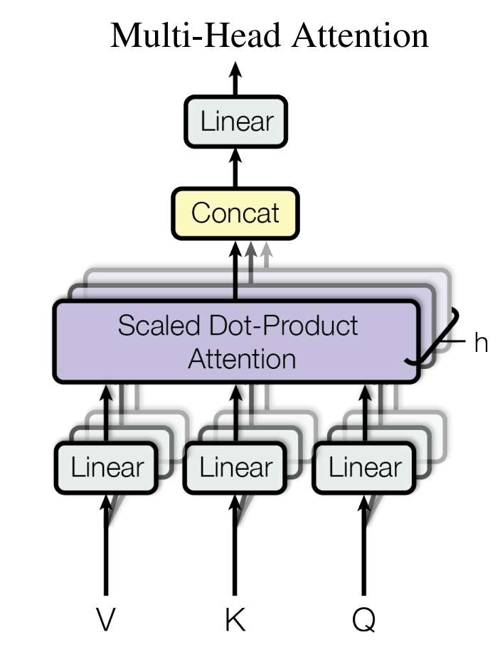
Multi-Head Attention — Architecture Diagram
V, K, Q — same input
All three come from the same embeddings X, projected through different linear layers.
h parallel heads
Each head independently runs scaled dot-product attention, learning its own W_Q, W_K, W_V.
Concat
Outputs of all h heads (each 64-dim) concatenated → 512-dim vector.
Linear (W_O)
Final projection integrates all head outputs into one coherent representation.
Source: jtlicardo.com/blog/self-attention-mechanism

Slide 12
The Transformer Encoder Block
Self-attention sits inside a larger block that adds normalisation and a feed-forward network.
Input Embeddings + Positional Encoding
Token vectors with position info injected.
Multi-Head Self-Attention
Tokens attend to each other. Core mechanism.
Add & Norm (Residual Connection)
Input is added back — helps gradients flow during training.
Feed-Forward Network (FFN)
Two linear layers with ReLU. Processes each token independently.
Add & Norm (Residual Connection)
Another skip connection after the FFN.
Output (Repeat N times)
Stack multiple encoder blocks (e.g. 12 in BERT, 6 in original paper).

Slide 13
PART 2
Vision Transformers
(ViT)
"An Image is Worth 16×16 Words" — Dosovitskiy et al., Google Brain, 2021
Applying the Transformer architecture — unchanged — to image classification

Slide 14
From NLP to Vision: Can Transformers Handle Images?
NLP Transformers
ViT: Transformers for Images
1
Input: sequence of word tokens
1
Input: image split into 16×16 pixel patches
2
Tokens → embeddings (dense vectors)
2
Patches → flattened + linear embedding
3
Positional encoding for order
3
Learnable positional embeddings for patch order
4
Transformer encoder processes sequence
4
Same Transformer encoder processes patches
5
Output: class / next token / translation
5
CLS token used for final classification
The transformer architecture is used almost unchanged — only the input representation differs.

Slide 15
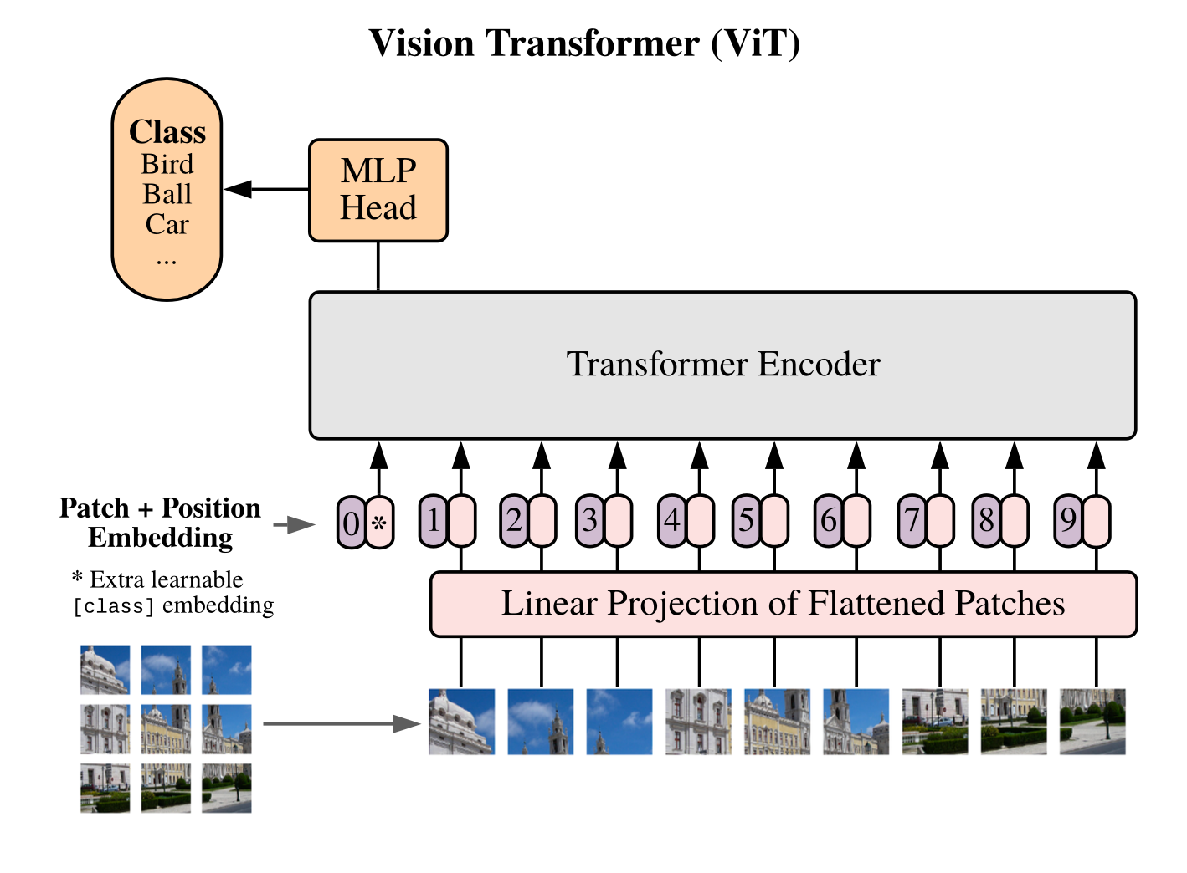
Step 1: Slice the Image into Patches
Patch Size: 16×16 pixels
A 224×224 image → 14×14 = 196 patches. Each patch is the transformer's "word".
Flatten Each Patch
16×16×3 (RGB) = 768 numbers per patch. Flattened to a 1D vector.
Linear Projection
Each 768-vector is projected to dimension D (e.g. 768 or 1024) via a learned weight matrix.
Result
A sequence of N patch embeddings — directly usable by a standard Transformer encoder.
Source: oxen.ai — Arxiv Dives: Vision Transformers

Slide 16
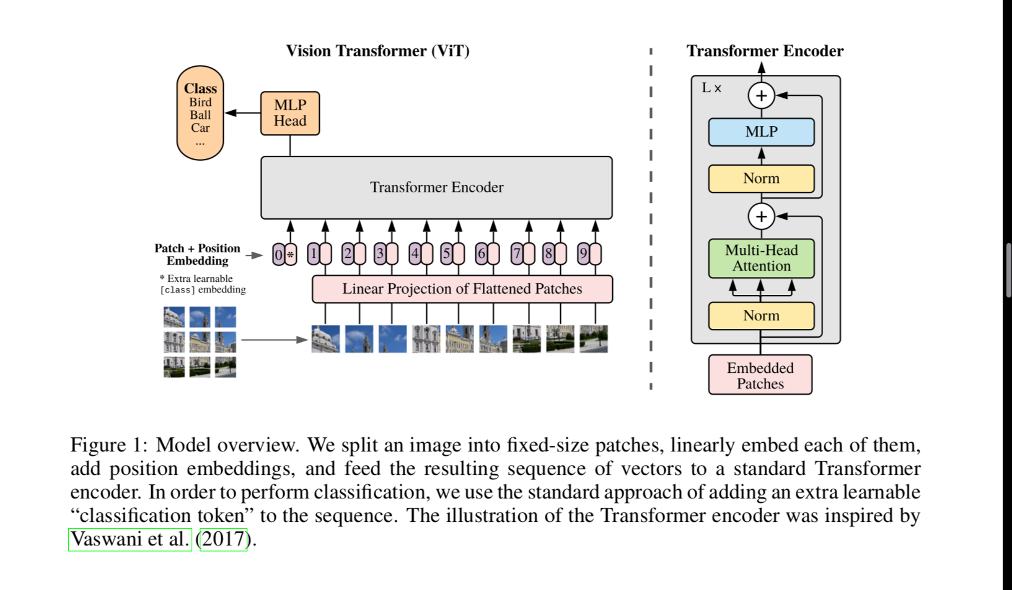
ViT Architecture — Full Pipeline
Image Patches
Patch + Position
Embedding
Transformer
Encoder ×N
MLP
Head
Class
Label
Source: Dosovitskiy et al. 2021 via oxen.ai

Slide 17
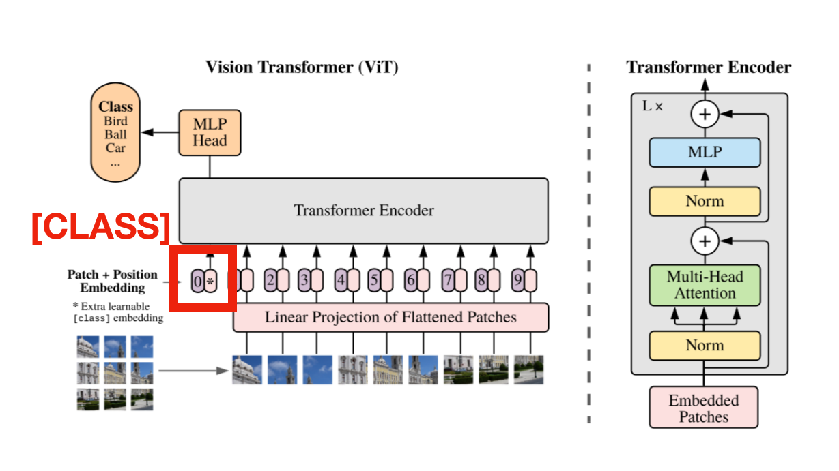
CLS Token & Positional Encoding
Positional Encoding in ViT
Why needed?
Transformers have no built-in notion of order — without position info, all patches are treated as a bag.
1D Learnable Positions
ViT uses simple learnable 1D position embeddings. Despite being 1D, the model can infer 2D position because row × width gives the absolute location.
Added to patch embeddings
Each patch embedding = linear projection of patch pixels + position vector for its index.
CLS Token (Learnable Classification Token)
Key finding
2D positional encodings showed no significant improvement over 1D in ViT experiments.
A special learnable token prepended to the patch sequence. By the end of the encoder, it aggregates information from all patches and is used for the final classification decision.
Source: Dosovitskiy et al. 2021 via oxen.ai

Slide 18
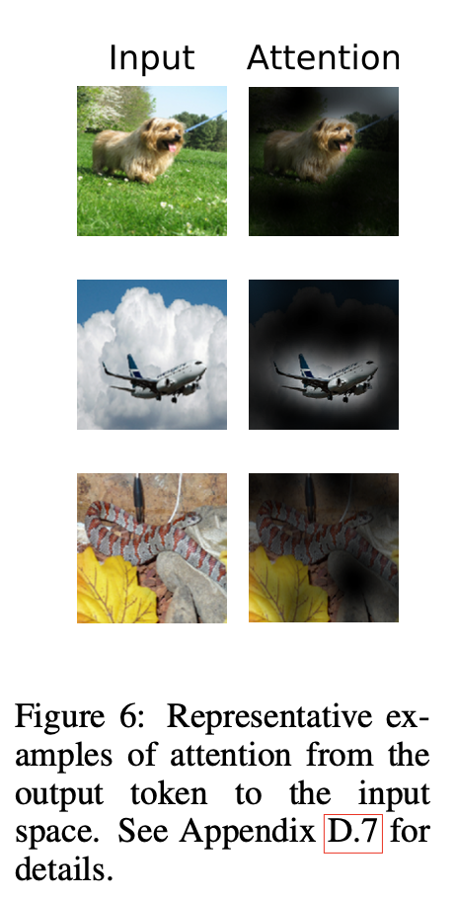
What Does ViT Actually Look At?
Attention Visualisation
Global from the start
Unlike CNNs, ViT can attend to distant patches even in its earliest layers.
Semantic focus
Attention heads learn to highlight object-relevant regions (ears, eyes, body contours).
Multiple heads specialise
Some heads look nearby; others span the whole image — complementary coverage.
Interpretable
Attention weights can be visualised and mapped back to image regions, giving insight into model decisions.
Source: @mensweardog / oxen.ai — Arxiv Dives ViT

Slide 19
CNNs vs Vision Transformers
Feature
CNNs (ResNet)
ViT
Inductive Bias
High — locality + translation invariance baked in
Low — must learn spatial structure from data
Small Datasets
✅ Works well with less data
❌ Needs large datasets to match CNN accuracy
Large Datasets
Good performance
✅ Matches or exceeds CNNs at 14M–300M images
Global Context
Requires many stacked layers to reach far
✅ Global attention in every single layer
Compute Efficiency
More compute per image
✅ More efficient per FLOP — better GPU parallelism
Interpretability
Limited (activation maps)
✅ Attention weights visualisable
Key finding: ViT's lower inductive bias is a weakness on small data but a strength at scale.

Slide 20
PART 3
DETR
(Detection Transformer)
"End-to-End Object Detection with Transformers" — Carion et al., Facebook AI Research, 2020
No anchors. No NMS. One unified end-to-end model.

Slide 21
Traditional Object Detection — What's Wrong?
Detectors like Faster R-CNN rely on hand-crafted components that complicate training.
1
Anchor Boxes
2
Region Proposal Network (RPN)
Pre-defined boxes of different sizes and ratios must be manually tuned per dataset. A hyper-parameter nightmare.
A separate sub-network proposes candidate regions before classification. Two-stage = more complexity.
3
Non-Maximum Suppression (NMS)
4
Fragile Pipeline
Removes duplicate detections post-prediction. Hand-tuned threshold, not learned, not differentiable.
Each component is trained or tuned separately. Errors cascade and the system is hard to optimise end-to-end.
DETR eliminates all of these in a single, trainable end-to-end architecture.

Slide 22
DETR — The Core Idea: Set Prediction
Object detection as a direct set prediction problem.
Given an image, predict a set of (class, bounding box) pairs — no ordering, no duplicates, all in one pass.
1
Fixed N Predictions
2
Object Queries
DETR always predicts exactly N=100 object slots. Slots that correspond to "no object" output a special ∅ (no-object) class.
N learnable embeddings fed into the decoder. Each query learns to ask about objects at specific image locations.
3
Bipartite Matching (Training)
4
End-to-End Training
Hungarian algorithm finds the optimal 1-to-1 match between predictions and ground truth. Ensures unique assignments.
The entire system — backbone, encoder, decoder, prediction heads — is trained with a single loss function jointly.

Slide 23
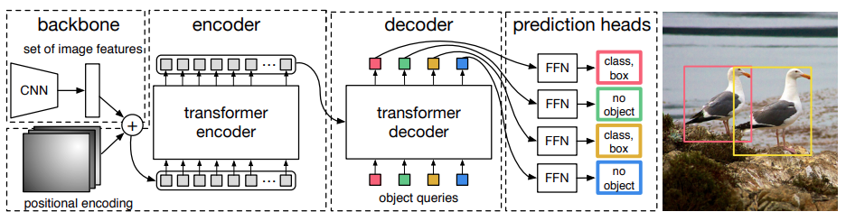
DETR Architecture — Full Pipeline
CNN Backbone
Transformer
Encoder
Transformer
Decoder
Prediction
Heads (FFN)
Source: Carion et al. 2020 via blog.roboflow.com

Slide 24
DETR — Component by Component
1
ResNet-50/101 extracts a feature map from the input image. Output: H/32 × W/32 × C spatial feature grid, flattened to a sequence.
CNN Backbone
2
Spatial (2D) positional encodings added to feature map. Unlike NLP (1D), object positions are 2-dimensional.
Positional Encoding
3
Flattened features processed with self-attention. Each position can reason about every other position in the image.
Transformer Encoder
4
N=100 learnable embeddings. Each query specialises in detecting objects in certain regions. Cross-attends to encoder output.
Object Queries (Decoder)
5
Two parallel MLP heads per query: (1) class label prediction, (2) bounding box coordinates (normalised cx, cy, w, h).
Prediction FFNs

Slide 25
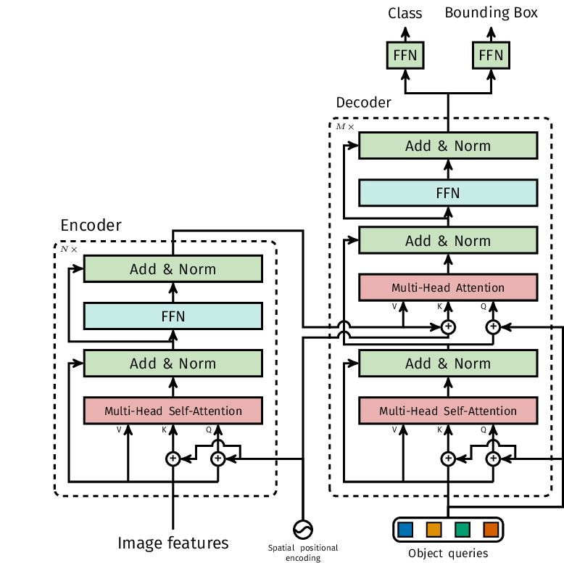
DETR — Transformer Encoder-Decoder Detail
Encoder vs Decoder
Encoder (top)
Self-attention on image features. All spatial positions reason about each other.
Decoder (bottom)
Object queries cross-attend to encoder output. Each query produces one detection.
Multi-head Attn
Both encoder and decoder use the same multi-head attention mechanism we studied in Part 1.
Parallel decoding
All N queries are decoded simultaneously — unlike language models, no autoregression.
Source: Carion et al. 2020 via blog.roboflow.com

Slide 26
Bipartite Matching — How DETR Trains
Challenge: 100 predictions, but only 3 ground truth objects. Which prediction should be penalised for which mistake?
1
Compute Cost Matrix
2
Hungarian Algorithm
For every predicted box vs every ground truth object, compute a cost combining class probability and box distance.
Finds the optimal 1-to-1 assignment minimising total cost. Each ground truth is matched to exactly one prediction.
3
Unmatched → ∅
4
Compute Loss & Backprop
The remaining N−|GT| predictions are assigned to the 'no-object' class (∅). Loss encourages them to predict background.
Standard cross-entropy for class labels + L1 + GIoU loss for bounding boxes. The whole model trained jointly.
This elegant matching is what allows DETR to train without hand-crafted anchors or NMS.

Slide 27
DETR — Strengths & Limitations
✅ Strengths
❌ Limitations
✓
End-to-end — no anchors, no NMS needed
✗
Slow training — 500 epochs needed vs ~36 for Faster R-CNN
✓
Parallel decoding — all objects at once
✗
Fixed query count — must set N in advance
✓
Strong at detecting occluded objects via global attention
✗
Struggles with small objects (limited spatial resolution)
✓
Simple, clean architecture — easy to extend
✗
Computationally heavy — full image attention is expensive
✓
Naturally handles varying object counts
✗
Superseded by RT-DETR and other successors
DETR's importance is architectural — it proved transformers can replace the full detection pipeline end-to-end.

Slide 28
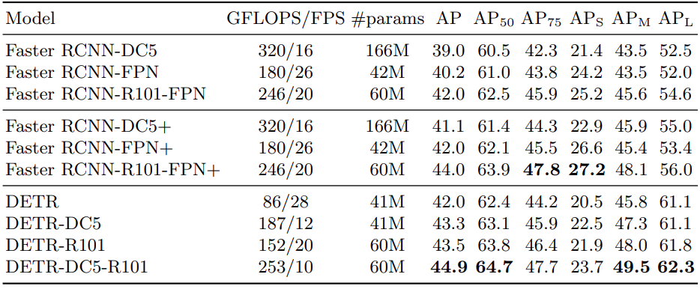
DETR Performance vs Faster R-CNN (COCO)
Competitive accuracy
DC5 = dilated backbone
Architectural proof
DETR-DC5-R101 achieves 44.9 AP on COCO — on par with Faster R-CNN baselines.
Dilated C5 stage improves feature resolution, especially for small objects.
DETR showed that a pure transformer approach to detection is viable — paving the way for successors.
Source: Carion et al. 2020 via blog.roboflow.com

Slide 29
Connecting the Dots: One Mechanism, Three Applications
Self-Attention is the engine. ViT and DETR are two ways to drive it in computer vision.
Self-Attention
Vision Transformer (ViT)
DETR
Core mechanism
Images as sequences
Detection as set prediction
→
Q, K, V from same input
→
Image → patches → tokens
→
CNN features → encoder
→
Scaled dot-product formula
→
CLS token for classification
→
Object queries → decoder
→
Multi-head = multiple views
→
Encoder-only architecture
→
Bipartite matching loss
→
Learns what to attend to
→
Works at Google scale
→
No anchors, no NMS

Slide 30
Session 14 — Key Takeaways
Self-Attention
Allows every token to directly attend to every other — solving RNNs' sequential bottleneck.
QKV Formula
Attention(Q,K,V) = softmax(QKᵀ / √dk) × V — compute scores, scale, normalise, blend.
Multi-Head
Multiple attention heads capture different relationship types simultaneously (syntax, semantics, long-range).
ViT
Images split into 16×16 patches treated as tokens. Works better than CNNs at large data scale.
DETR
Object detection reframed as set prediction. Object queries + bipartite matching replace anchors and NMS.
Big picture
One attention mechanism, applied differently, powers image classification and object detection.

